Slide 1
Project 3
Countries Wealth
Kimberly
Lyndsay
Ben
Nick
Will

Slide 2

Background
We compared the GDP, GNI and debt-to-GDP of the top countries in the last 10 years (300 data points), in order to analyze the overall strength of each economy, as well as the strength of the economy in correlation to income from foreign markets and its ability to pay back its debt.

Slide 3

GDP, GNI & Debt to GDP?
GDP (gross domestic product) refers to the aggregate market value of all the finished goods and services produced by a country
GNI (gross national income) which takes into account a country's GDP and net income earned abroad
Debt-to-GDP The Debt-to-GDP ratio is a formula that compares a country's total debt to its economic productivity. To get the debt-to-GDP ratio, divide a nation's debt by its gross domestic product.

Slide 4
Why those 3?
(GDP) is among the most popular of economic indicators, (GNI), is quite possibly a better metric for the overall economic condition of a country whose economy includes substantial foreign investment. This is because the GNI calculates an economy's total income, regardless of whether the income is earned by nationals within the country's borders or derived from investments in foreign business.
-Investopedia

Slide 5

The Process
Extract - API Calls and CSV files
Downloaded data from World Bank on GDP and GNI from 2012 to 2021.
Transform - Jupyter
Read in data files and cleaned data frames to have a uniform format as well as at least one shared column for postgres load.
Load - Postgres
Set up a connection to our Postgres database and loaded the newly cleaned and formatted data in.
Dashboard
Used Bootstrap to create an interactive dashboard for users to easily view data.
Visualizations
Line Chart
Our first line chart displayed each countries GDP over the last 10 years plotted on top of each other.
Our second line chart displayed each countries GNI over the last 10 years plotted on top of each other.
Pie chart
We used Chart.js to create and display a pie chart of each countries Debt-to-GDP Ratio.
Maps
For our map, we intended to create a webpage that would allow a user to utilize a drop down menu of years, and based on that selection, the map would rebuild itself and display the countries GDP for the selected year.

Slide 6


Resources
Data World Bank.org
MacroTrends

Slide 7
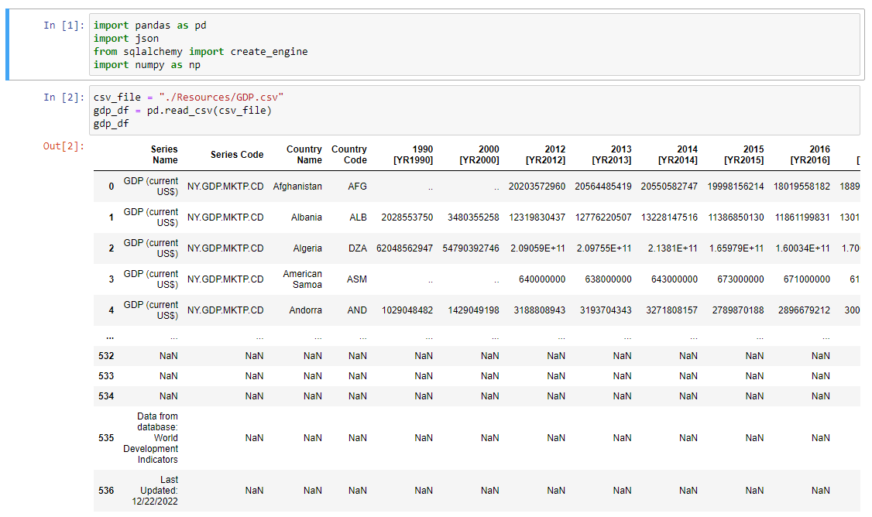
Data clean up
GDP, GNI & Debt-to-GDP

Slide 8
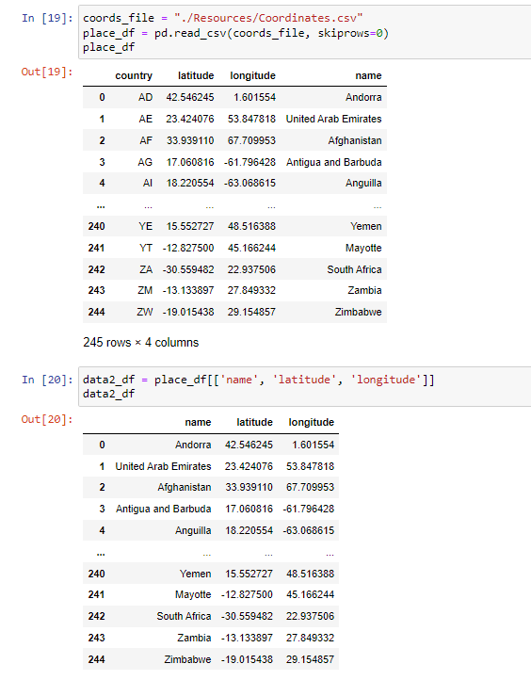
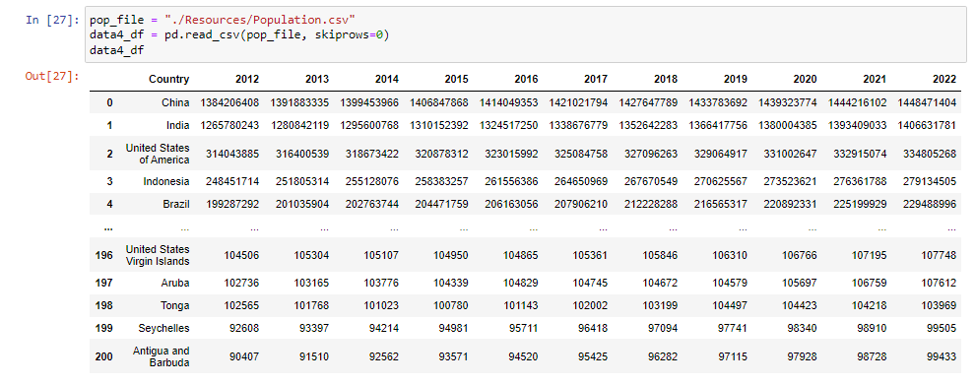
Added
Coordinates & Population

Slide 9
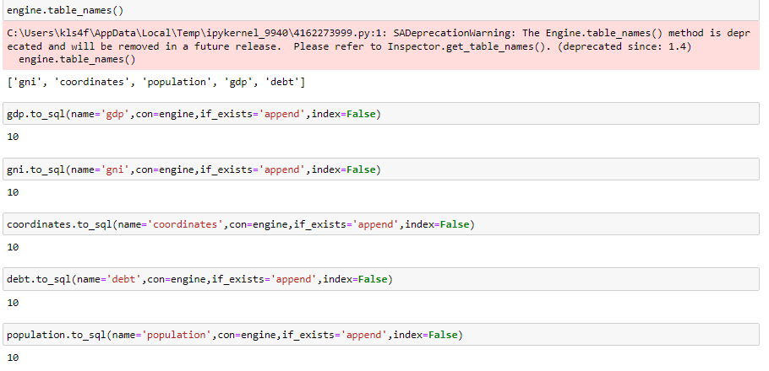
Created Tables

Slide 10
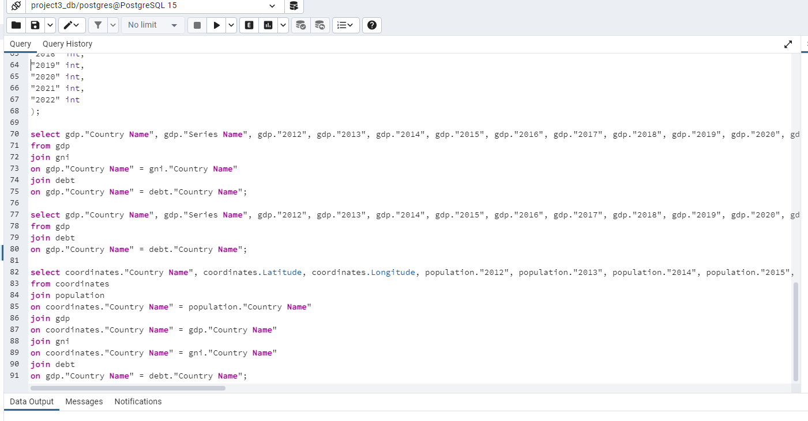
Postgres

Slide 11
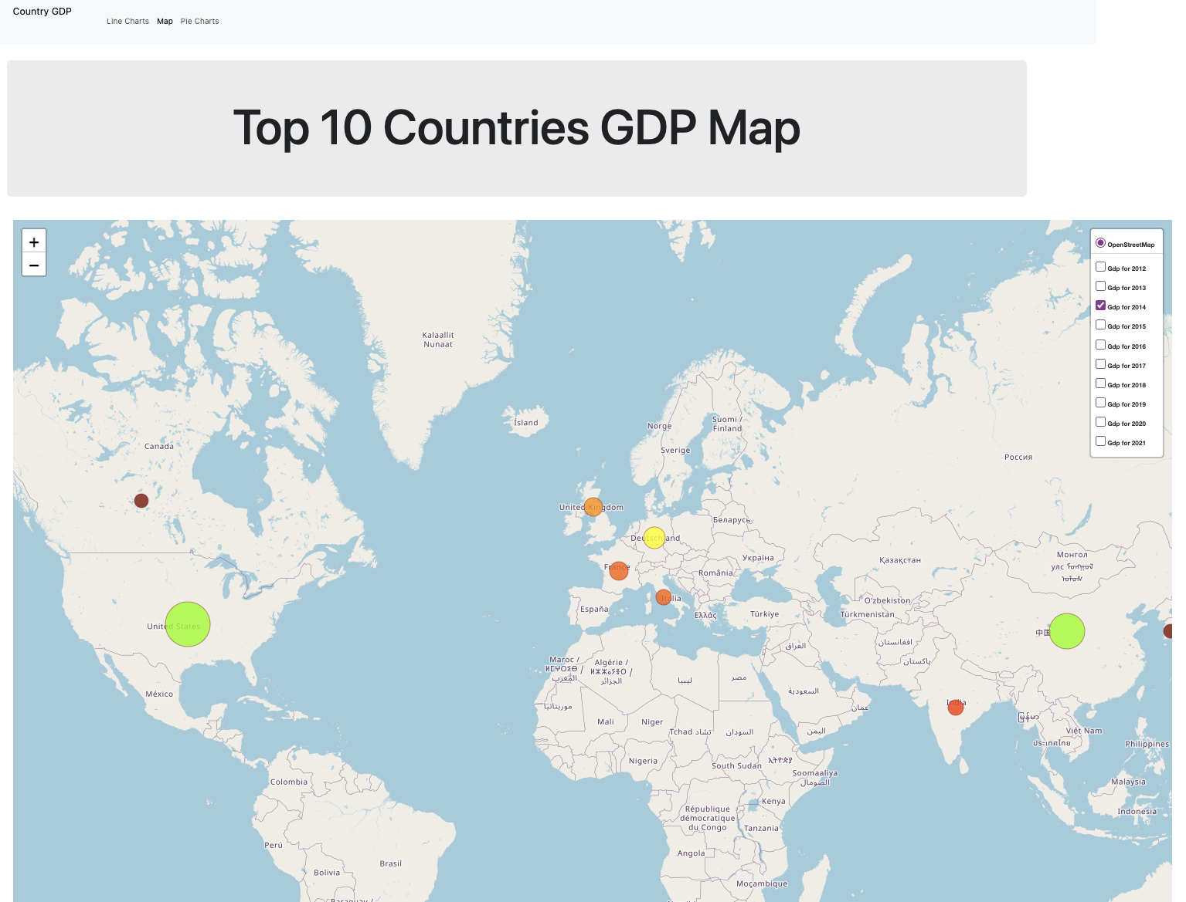
Map and GeoJson
For our map, we had to create a second api structure that turned our original JSON data into a geojson structure.
After plotting the base map, we attempted to create a function updateMap() that would take in the user’s selection of year from a dropdown and pass it back through the json data to extract the correct value for each country.
The error we faced was our map was already initialized when trying to render a new map and new markers for a different year.
Our solution was to create a map with a layer for each year’s GDP instead.

Slide 12
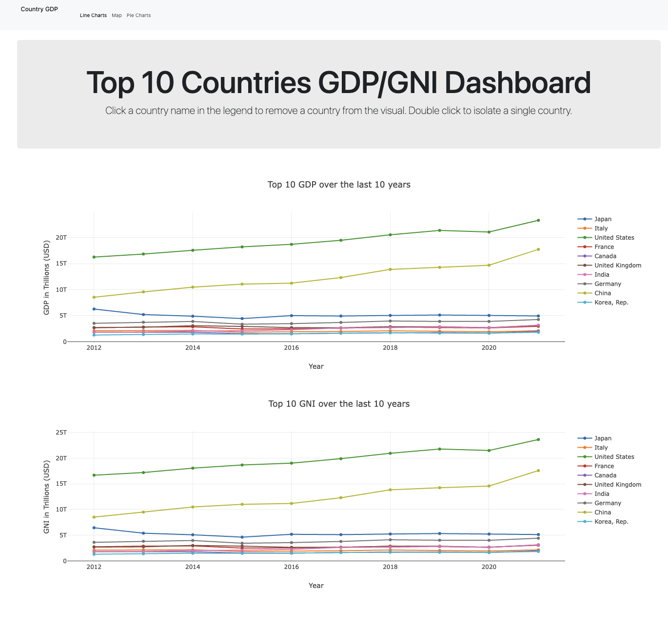
Graphs and Charts
For the line charts, we had to make an api call to our database to grab each years’ GDP value for each country.
In order to do so, we created a list of years and used an arrow function to map each item to the correct year.
On the dashboard, if you double click a country in the legend, the graph updates to show the trend line for just that country.
If you single click on a country, it will remove the trend line from the chart.

Slide 13
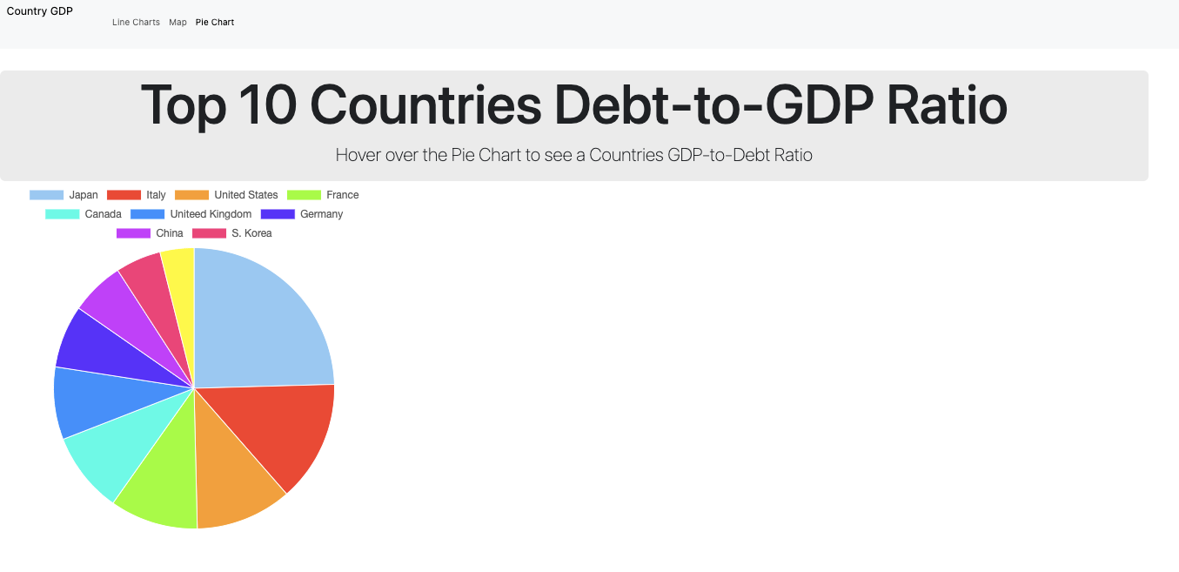
Pie Chart and Chart.js Library
Experience using Chart.js
HTML based
Written in script tags
Pros/Cons of Chart.js

Slide 14
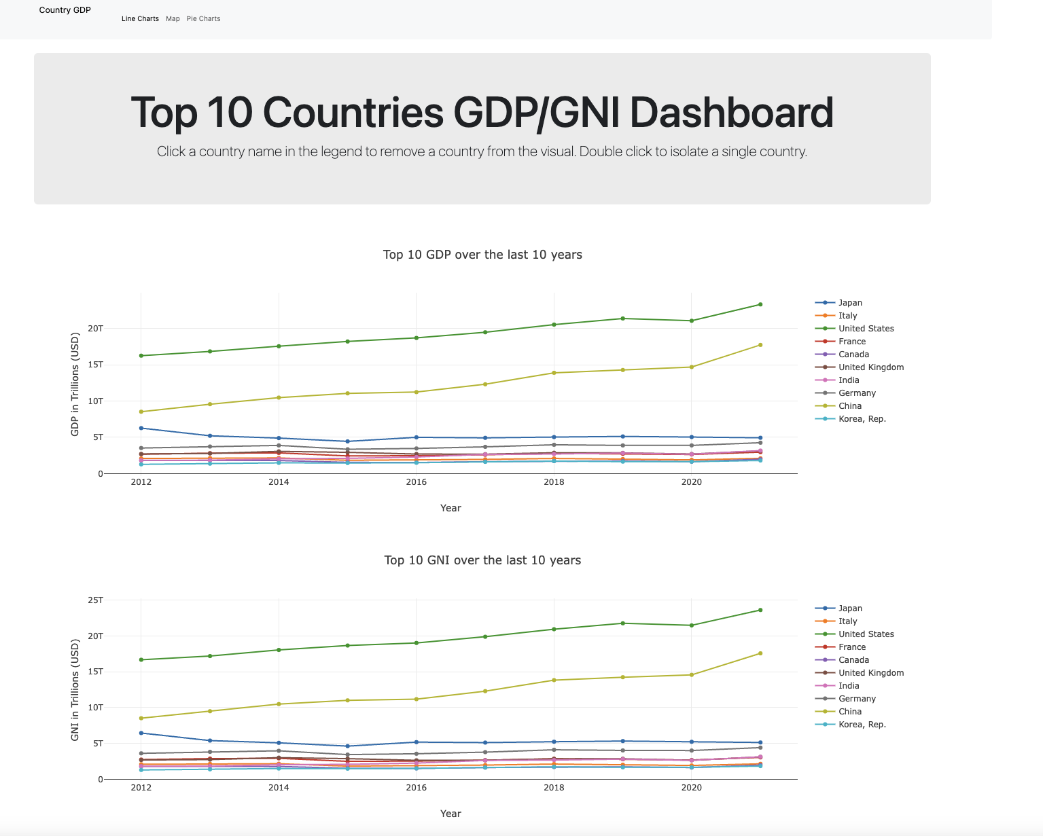
Dashboard
Line Charts link
Interactivity thru plotly
Map link
10 layers, one for each year
Pie Charts
Showcases debt–to-gdp ratio

Slide 15
Top 10 GDP- 2022
United States: $20.89 trillion
China: $14.72 trillion
Japan: $5.06 trillion
Germany: $3.85 trillion
United Kingdom: $2.67 trillion
India: $2.66 trillion
France: $2.63 trillion
Italy: $1.89 trillion
Canada: $1.64 trillion
South Korea: $1.63 trillion

Slide 16
Top 10 GNI- 2022
1 United States of America (USA)
2. China
3. Japan
4. Germany
5. United Kingdom
6. France
7. India
8.Italy
9. South Korea
10.Canada

Slide 17
Debt-to GDP 2023
Japan 237%
Greece 177%
Lebanon 151%
Italy 135%
Singapore 126%
Cape Verde 125%
Portugal 117%
Angola 111%
Bhutan 110%
Mozambique 109%

Slide 18
Questions?

